Slide 1
Regularization
In
Neural Network

Slide 2
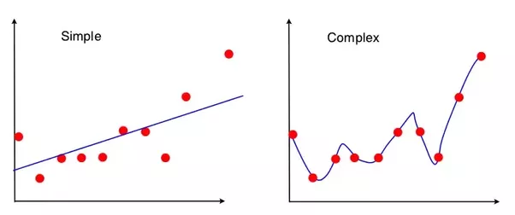
Overview

Slide 3
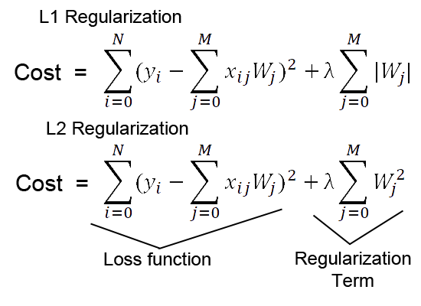
Regularization

Slide 4
Dropout
Standard Neural Network
After Applying Dropout
p1
p2
p3

Slide 5
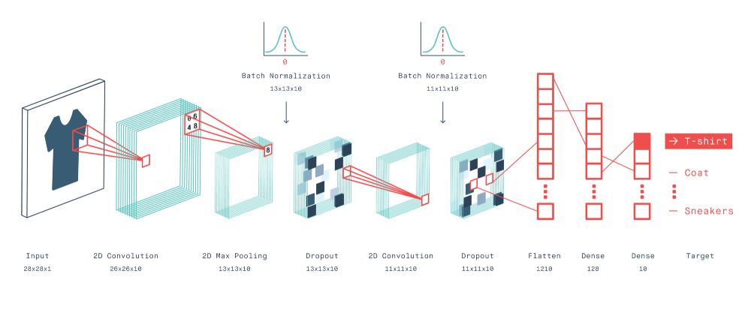
Dropout in CNN

Slide 6
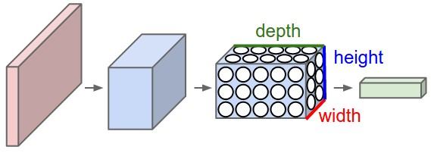

Slide 8
Convolution Layer

Slide 9
Convolution With Dropout
7 | 2 | 3 | 3 | 8
4 | 5 | 3 | 8 | 4
3 | 3 | 2 | 8 | 4
2 | 8 | 7 | 2 | 7
5 | 4 | 4 | 5 | 4
1 | 0 | -1
1 | 0 | -1
1 | 0 | -1
6 | -9 | -8
-3 | -2 | -3
-3 | 0 | -2
*
=
7 | 2 | 0 | 3 | 8
4 | 5 | 3 | 0 | 4
0 | 3 | 2 | 8 | 0
2 | 8 | 0 | 2 | 7
5 | 0 | 4 | 5 | 4
1 | 0 | -1
1 | 0 | -1
1 | 0 | -1
6 | -1 | -7
1 | 6 | -6
1 | -4 | -5
*
=

Slide 10
DropBlock

Slide 11
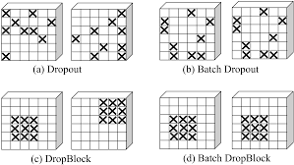
Variations to Dropout

Slide 12
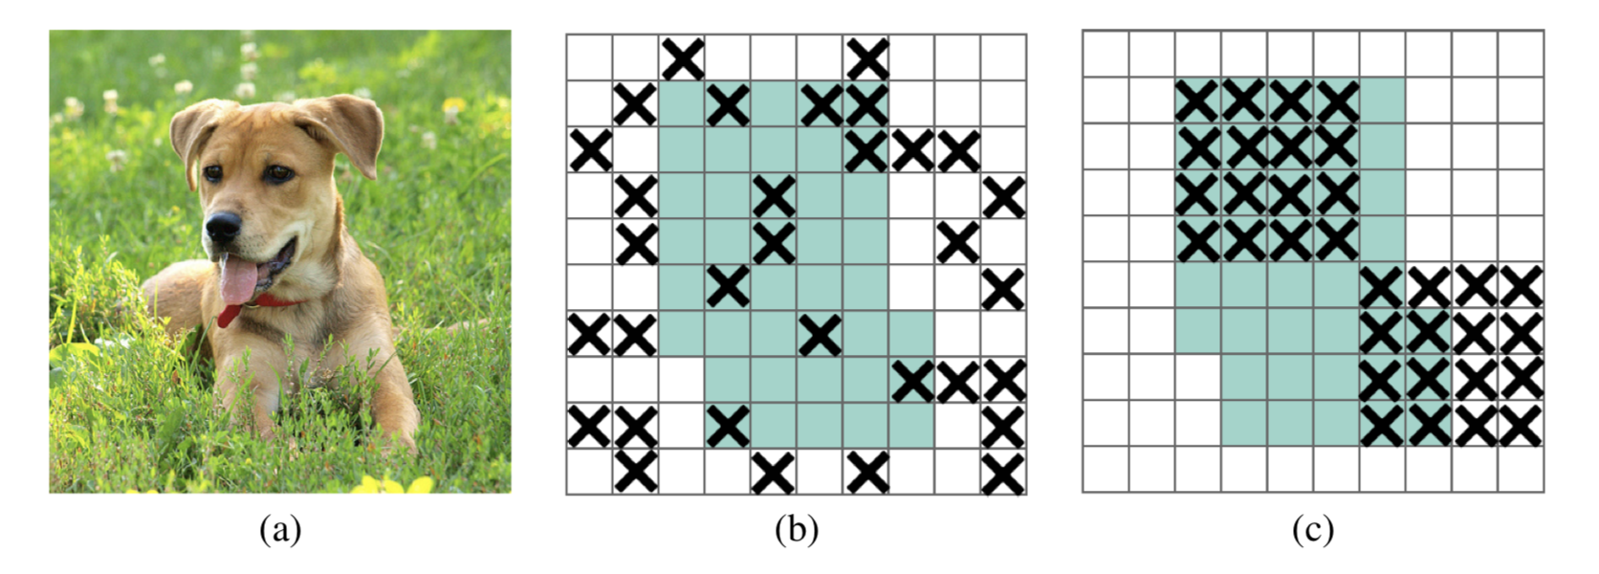
DropBlock

